Slide 1
Problem Statement
Introduction to GenAI and Simple LLM Inference on CPU and fine tuning of LLM Model to create a Custom Chatbot”
MediGuide- Your Personal Health Navigator
Health issues can often be challenging to identify accurately, leading to delays in seeking appropriate medical care. To address this issue, we propose developing a health chatbot that utilizes machine learning techniques to analyze user-entered symptoms and suggest potential diseases.The chatbot will provide personalized health advice and precautions, aiming to empower users with timely and reliable health information. We propose a health chatbot that leverages Intel extensions for Modin and scikit-learn to design a robust machine learning model.

Slide 2
Unique Idea Brief (Solution)
The HealthCare ChatBot project leverages machine learning algorithms to create an interactive system that assists users in identifying potential health issues based on their symptoms. Here are the unique aspects of the project:
Integrated Decision Support: The bot not only predicts diseases but also suggests precautions and provides detailed descriptions for each diagnosis, making it a comprehensive health assistant.
Severity Analysis: By assessing the severity of symptoms based on user input (duration and type), the chatbot gives tailored advice on whether to seek medical consultation or take precautionary measures.
Customizable Machine Learning Models: Users can potentially extend or modify the model to include more symptoms or diseases, enhancing its applicability and accuracy.
Pattern Recognition for Symptom Input: The bot uses regex pattern matching to interpret user input, allowing it to handle variations in symptom descriptions effectively.
User-Driven Learning: The chatbot can be updated with new data (like emerging diseases or symptoms), ensuring it remains relevant and useful in changing health landscapes.
These features collectively create a robust platform for users to interact with their health information, promoting proactive health management through technology.

Slide 3
Features Offered
User Interaction:
  Personalized Greeting: The chatbot prompts users for their name and greets them.
Symptom Input:
  Symptom Entry: Users can enter symptoms they are experiencing.
Symptom Recognition:
  Pattern Matching: Validates user inputs and suggests possible symptoms based on user input.
Disease Prediction:
  Decision Tree Classifier: Utilizes a decision tree model to predict diseases based on symptoms.
  Secondary Prediction: Allows for a follow-up prediction based on additional symptoms provided by the user.
Severity Assessment:
  Severity Calculation: Evaluates the severity of reported symptoms and advises whether to seek medical consultation.
Information Retrieval:
  Disease Descriptions: Provides detailed descriptions of predicted diseases.
  Precautionary Measures: Offers specific precautions for each predicted disease.
Interactive Experience:
  Guided Input: Walks users through the symptom reporting process, ensuring clarity and accuracy.
Dynamic Feedback:
  Immediate Responses: Provides real-time feedback and suggestions based on user inputs.

Slide 4
Process flow
User Interface Layer:
  User interaction with the chatbot.
Input Processing:
  Regular Expressions: For specific symptom pattern matching using NLP principles.
Core Processing Layer:
  Chatbot Logic: Manages conversation flow and logic.
  Data Retrieval: Loads symptom data, severity, and precautions from CSV files.
Machine Learning Layer:
  Intel Scikit-learnex:
    Model Training: Uses Decision Trees and SVMs for prediction.
    Model Prediction: Executes trained models for symptom analysis and prognosis.
  Intel Modin:
    Data Manipulation: Handles data preprocessing and analysis efficiently.
Output Processing:
  Response Generation: Generates appropriate responses based on predictions.
User Feedback Loop:
  User Input: Collects feedback on the chatbot responses for continuous improvement.

Slide 5
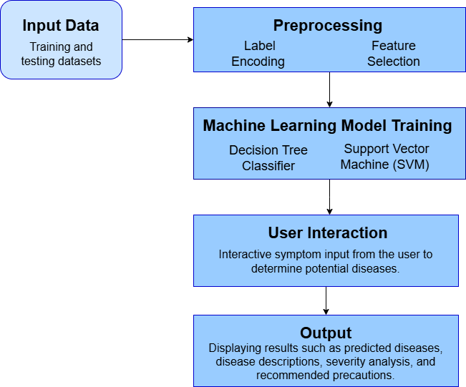
Architecture Diagram

Slide 6
Technologies used
Programming Language: Python
Data Manipulation: Modin (parallelized DataFrame operations) and Pandas (data manipulation)
Machine Learning:
Scikit-learn (Intel Extension):
  Models :
    Decision Tree Classifier
    Support Vector Classifier (SVC)
  Utilities:
    Preprocessing tools
    Cross-validation
    Model Evaluation
Numerical Operations: NumPy

Slide 7
Team members and contribution:
Siri H- Data collection and processing
  Set up the dataset folder and place all CSV files inside.
  Write scripts to load and preprocess data from CSV files.
  Implement functions to create dictionaries for symptoms, severity, descriptions, and precautions.
Akshatha A- Model Development
  Develop and train the Decision Tree and SVM models.
  Implement cross-validation and feature importance extraction.
  Write the sec_predict() function for secondary prediction based on symptoms.
H R Sankhya- Testing and Optimization
  Implement pattern matching and symptom-checking logic.
  Develop the command-line interface for user interaction and integrate the machine learning models with it.
  Designing scenarios to validate the accuracy of the chatbot predictions against known outcomes.

Slide 8
Conclusion
The healthcare chatbot application effectively utilizes machine learning techniques, particularly decision tree classifiers and support vector machines, to assist users in identifying potential health issues based on reported symptoms. By guiding users through a structured interaction process—from symptom entry to disease prediction and precautionary advice—the chatbot enhances accessibility to healthcare information.
Its user-friendly interaction allows individuals to easily provide necessary information, while the intelligent symptom recognition ensures relevant responses. Leveraging advanced algorithms, the application offers accurate predictions and evaluates symptom severity to suggest appropriate actions. Users benefit from detailed descriptions and precautions related to their predicted health conditions, empowering them to make informed decisions regarding their health.
Overall, this chatbot serves as a valuable tool for preliminary health assessments, promoting early detection and proactive management of health issues while encouraging users to seek professional medical advice when necessary.

